Slide 1
DOWNSCALING
Downscaling’ techniques, [are] commonly used to address the scale mismatch between coarse resolution global climate model (GCM) output and the regional or local catchment scales required for climate change impact assessment

Slide 2

Statistical Downscaling Model (SDSM)
Developed by Loughborogh university, UK
www.sdsm.org.uk
Data can be downloaded from Canadian Climate Change Scenario network (CCSN)
http://www.cccsn.ca/?page=dst-sdi
SDSM is best described as a hybrid of the stochastic weather generator and transfer function methods.

Slide 3
http://scenarios-climatiques.canada.ca/?page=pred-canesm2#

Slide 4
SDSM Algorithm
Optimisation Algorithm: SDSM 4.2 provides two means of optimising the model – Dual Simplex (as in earlier versions of SDSM) and Ordinary Least Squares. Although both approaches give comparable results, ordinary Least Squares is much faster.

Slide 5
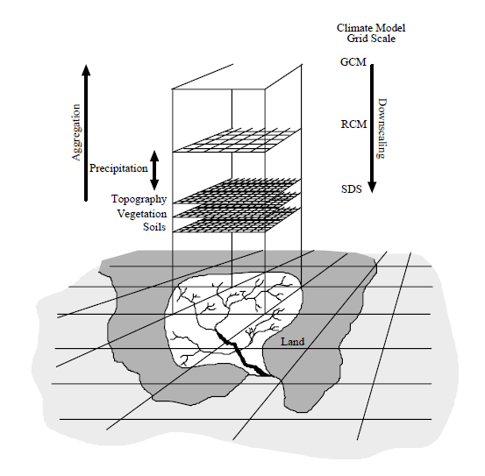
Downscaling
Applicable to:
•Sub-grid scales (small islands, point processes)
•Complex/ heterogeneous environments
•Extreme events
•Exotic predictands
•Transient change/ ensembles
1/31/2019

Slide 6
DOWN SCALING
DOWNSCALING is the transformation from a LARGE SCALE feature to a SMALL SCALE one (not necessarily of the same kind).
DOWNSCALING implies increases resolution of output.

Slide 7
Downscaling methods
DYNAMICAL DOWNSCALING
STATISTICAL DOWNSCALING WEATHER GENERATORS

Slide 8
Methodology
Precipitation Downscaling
Download GCM Predictors
The GCM contains NCEP/NCAR reanalysis predictor variables, predictors for historical data from 1961 to 2006 and 3 sets of RCP scenarios (RCP 2.6, 4.5 and 8.5).
The grid size of the predictors is 2.8125° x 2.8125°.
Predictand (Precipitation)
RCP 8.5, RCP 4.5 and RCP 2.6 forcing predictor variables
NCEP Predictor variables
Screening Predictors
Data Quality Control and Arranging in SDSM format
Model Calibration/Validation
Weather Generator
Summary Statistics and Frequency Analysis
Scenario Generation
Downscaled data for scenarios RCP 8.5, 4.5 and 2.6
Downscaling process using SDSM

Slide 9
Methodology contd…
S.N. | Predictor variables | Description of predictor variables | S.N. | Predictor variables | Description of predictor variables
1 | mslpgl | Mean seal level pressure | 14 | p5zhgl | 500hPa Divergence of true wind
2 | p1_fgl | 1000hPa Wind speed | 15 | p850gl | 850hPa Geopotential
3 | p1_ugl | 1000hPa Zonal wind component | 16 | p8_fgl | 850hPa Wind speed
4 | p1_vgl | 1000hPa Meridional wind component | 17 | p8_ugl | 850hPa Zonal wind component
5 | p1_zgl | 1000hPa Relative vorticity of wind | 18 | p8_vgl | 850hPa Meridional wind component
6 | p1thgl | 1000hPaWind direction | 19 | p8_zgl | 850hPa Relative vorticity of wind
7 | p1zhgl | 1000hPa Divergence of true wind | 20 | p8thgl | 850hPa Wind direction
8 | p500gl | 500hPa Geopotential | 21 | p8zhgl | 850hPa Divergence of true wind
9 | p5_fgl | 500hPa Wind speed | 22 | prcpgl | Total precipitation
10 | p5_ugl | 500hPa Zonal wind component | 23 | s500gl | 500hPa Specific humidity
11 | p5_vgl | 500hPa Meridional wind component | 24 | s850gl | 850hPa Specific humidity
12 | p5_zgl | 500hPa Relative vorticity of wind | 25 | shumgl | 1000hPa Specific humidity
13 | p5thgl | 500hPa Wind direction | 26 | tempgl | Air temperature at 2m
Predictors are downloaded from website of CanESM2 for the desired station locations
Screening of predictors- a kind of selection of predictors among 26 predictors to get the best set of predictors that produce a good correlation with the predictand (here, precipitation)
The predictors were selected on the basis of significance level and correlation coefficient

Slide 10
Methodology contd…
Model Calibration and Validation
The model is calibrated and validated using daily precipitation data from 1980 to 2005 and 2006 to 2010 respectively.
The Ordinary least squares optimizing model, conditional process has been used for calibration with monthly sub model.
20 ensembles of daily weather data series were generated for simulation period of 1980 to 2010.
Future Climate Scenario Generation
20 ensembles were generated for three emission scenario from Representative Concentration Pathways (RCPs) 2.6, 4.5 and 8.5 for the period of 2006 to 2100 for all the stations.
Mean of 20 ensembles were used.
The generated future climate (precipitation) data was bias-corrected.

Slide 11
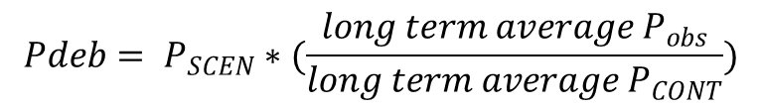
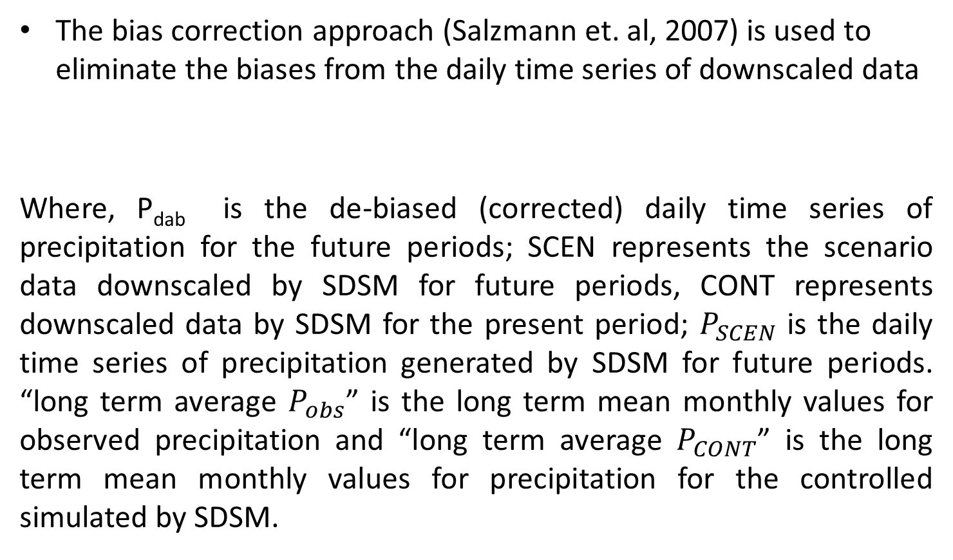
Methodology contd…
Bias Correction
The bias correction approach (Salzmann et. al, 2007) is used to eliminate the biases from the daily time series of downscaled data
Where, P_{dab} is the de-biased (corrected) daily time series of precipitation for the future periods; SCEN represents the scenario data downscaled by SDSM for future periods, CONT represents downscaled data by SDSM for the present period; $P_{SCEN}$ is the daily time series of precipitation generated by SDSM for future periods. “long term average $P_{obs}$” is the long term mean monthly values for observed precipitation and “long term average $P_{CONT}$” is the long term mean monthly values for precipitation for the controlled simulated by SDSM.
$$Pdeb= P_{SCEN}∗(\frac{long term average P_{obs}}{long term average P_{CONT}})$$

Slide 12
DownScaling Methods
Stochastic DownScaling - Probabalistic
Dynamical DownScaling - running a higher resolution RCM within a coarser resolution GCM.
Weather Typing approaches - grouping of countries with similar weather
Regression-based DownScaling - empirical relationships between local scale predictand and regional scale predictors.

Slide 13
Statistical downscaling
Statistical downscaling is a mathematical procedure that relates changes at the large spatial scale that GCMs simulate to a much finer scale
  For example, a statistical relationship can be created between variables simulated by GCMs such as air, sea surface temperature, and precipitation at the GCM scale (predictors) with temperature and precipitation at a particular location (predictands)

Slide 14
Statistical downscaling
Is most appropriate for
  Subgrid scales (small islands, point
  processes, etc.)
  Complex/heterogeneous environments
  Extreme events
  Exotic predictands
  Transient change/ensembles
Is not appropriate for
  Data-poor regions
  Where relationships between predictors and predictands may change
Statistical downscaling is much easier to apply than regional climate modeling

Slide 15
Statistical downscaling
Statistical downscaling assumes that the relationship between the predictors and the predictands remains the same
Those relationships could change
In such cases, using regional climate models may be more appropriate

Slide 16
STATISTICAL DOWNSCALING
WEATHER GENERATORS
Climate
observations
Global
Circulation
Pattern
observed
Calibration
Statistics
Class
Frequency
analysis
Statistics
Prediction
Global
Circulation
Pattern
predicted
Climate
predictions

Slide 17
STATISTICAL DOWNSCALING
CORRELATION MODELS
Climate
Observations
Calibration
GCM fields
Statistics
Statistics
Statistical relationship
Prediction
Modeled climate
Statistics

Slide 18
Down Scaling
Basically, downscaling is any process where large (coarse) scale output of models is reduced or made finer.
The first attempt to DownScale the global models was by the production of regional models. These regional models resolutions of 70 to 50 km square.
However there is still a need to go even further by Down Scaling.
This is what is require by impact researchers.

Slide 19
Developed by Dr. Rob Wilby, Dr. Christian Dawson and Dr. Elaine Barrow
Downscales GCM output from course grid to island or local level
SDSM is a hybrid of the multiple Regression and Stochastic DownScaling models.
The model assumes Stationarity - statistical properties of the variable being downscaled will not change over time.

Slide 20
Advantages of SDSM
Cheap - not computational demanding and is readily transportable.
Flexible - can be tailored to target a variety of variable e.g. storm surge.
Generates ensemble of climate scenarios - allows risk (uncertainty) analysis.
Rapid application to multiple GCM’s.
Complementary to regional modelling
Fairly simple to use and thus accessible beyond research community

Slide 21
Disadvantages of SDSM
Dependent on the realism of the GCM boundary forcing.
DownScaling in general propagates the GCM error.
Require high quality (daily, in our case) data for calibration of the model.
Relationship between predictor and predictand are often non stationary.
Predictor variables used explain only a portion of the variability.
Low frequency climatic variables are problematic to downscale.

Slide 22
Steps in downscaling
The process involves basically four steps
Gathering of the predictor (model output) and predictand variables (observed).
Screening: to decide which GCM to use, which variables are most relevant, the best predictor predictand relationships, the various locations in the different countries to downscale, the best transfer scheme to use.
Calibrating the model and Developing results for the different time slices.
Interpretation and Presentation of findings.

Slide 23
Overview of the SDSM:
Key functions of SDSM - Menu driven
‘Quality Control’ and ‘Transform’ data
‘Screen Variables’ (Selection of predictors)
‘Calibrate Model’ (Regression equations)
‘Weather Generator’ (Synthetic daily weather);
‘Analyse Data & Model Output’ (Statistics)
‘Compare Results’ (Graphs)
‘Generate Scenario’ (Synthetic daily weather using model predictors)

Slide 24
Data set
Predictors
Predictants

Slide 25
Predictors used and their code
Mean seas level pressure ncepmslpna
Surface air flow strength ncepp__fna
Surface zonal velocity ncepp__una
Surface meridonal velocity ncepp__vna
Surface vorticity ncepp__zna
Surface divergence ncepp_zhna
500 hpa air flow strength ncepp5_fna
500 hpa vorticity ncepp5_zna
500 hpa geopotential height ncepp500na
850 hpa zonal velocity ncepp8_una
850 hpa specific humidity nceps850na
Near surface specific humidity spncepsphuna
Mean temperature at 2 metre nceptempna

Slide 26
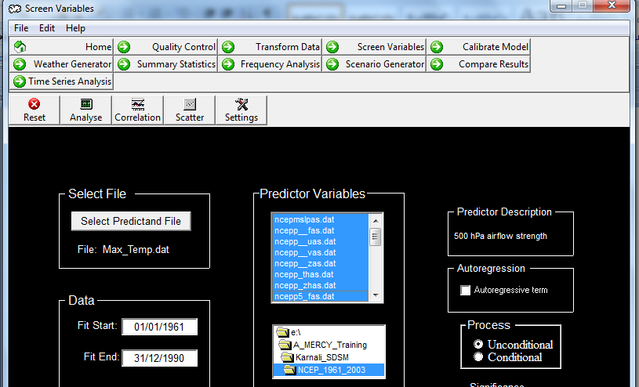
Predictand and Predictor

Slide 27
IPCC Data
Distribution Center
GCM data from (for example)
  CCC (Canada)
  CSIRO (Australia)
  ECHAM4 (Germany)
  GFDL-R30 (U.S.)
  HadCM3 (UK)
  NIES (Japan)
Can obtain actual (not scaled) GCM output

Slide 28
Predictants- Rainfall and Temperature
Predictants- Rainfall and Temperature
Predictors (and predictor code) used
Rainfall –
Surface vorticity - ncepp__zna.dat
850 hpa vorticity - ncepp8_zna.dat
Specific humidity at 500 hpa - nceps500na.dat
Specific humidity at 850 hpa - nceps850na.dat
Mean temperature at 2 metres - nceptempna.dat

Slide 29
Methodology
S.N. | Predictor variables | Description of predictor variables | S.N. | Predictor variables | Description of predictor variables
1 | mslpgl | Mean seal level pressure | 14 | p5zhgl | 500hPa Divergence of true wind
2 | p1_fgl | 1000hPa Wind speed | 15 | p850gl | 850hPa Geopotential
3 | p1_ugl | 1000hPa Zonal wind component | 16 | p8_fgl | 850hPa Wind speed
4 | p1_vgl | 1000hPa Meridional wind component | 17 | p8_ugl | 850hPa Zonal wind component
5 | p1_zgl | 1000hPa Relative vorticity of wind | 18 | p8_vgl | 850hPa Meridional wind component
6 | p1thgl | 1000hPaWind direction | 19 | p8_zgl | 850hPa Relative vorticity of wind
7 | p1zhgl | 1000hPa Divergence of true wind | 20 | p8thgl | 850hPa Wind direction
8 | p500gl | 500hPa Geopotential | 21 | p8zhgl | 850hPa Divergence of true wind
9 | p5_fgl | 500hPa Wind speed | 22 | prcpgl | Total precipitation
10 | p5_ugl | 500hPa Zonal wind component | 23 | s500gl | 500hPa Specific humidity
11 | p5_vgl | 500hPa Meridional wind component | 24 | s850gl | 850hPa Specific humidity
12 | p5_zgl | 500hPa Relative vorticity of wind | 25 | shumgl | 1000hPa Specific humidity
13 | p5thgl | 500hPa Wind direction | 26 | tempgl | Air temperature at 2m
Predictors are downloaded from website of CanESM2 for the desired station locations
Screening of predictors- a kind of selection of predictors among 26 predictors to get the best set of predictors that produce a good correlation with the predictand (here, precipitation)
The predictors were selected on the basis of significance level and correlation coefficient

Slide 30
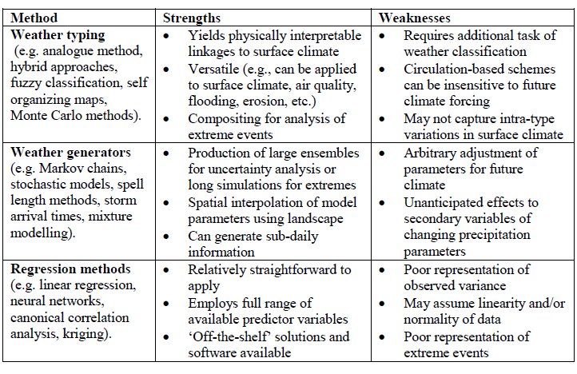
Strengths and weaknesses of statistical downscale

Slide 31
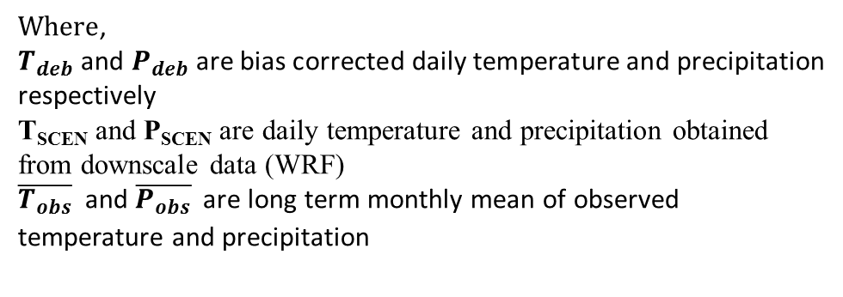


Future Climate data
The climate change data were downloaded using WRF model.
The data from selected co-ordinates were extracted Using GRADS program
The future climatic data; daily precipitation, maximum and minimum temperature of two different scenarios RCP 4.5 (from 1996 to 2050) and RCP 8.5 (2006 to 2050) were extracted
The extracted data consists of some biasness which is removed by using equations;
……(1)
……(2)

Slide 32
Temperature Bias correction

Slide 33
R² of Bias_Corrected

Slide 34
r²
r² | r<0.20 | Neglagible relationship
 | 0.30 to 0.49 | Low correlation
 | 0.50 to 0.69 | Moderate correlation
 | 0.70 t0 0.89 | High correlation
 | >0.90 | Very high correlation

Slide 35
Types of representative concentration pathways
Name | Radiative Forcing1 | Concentration2 | Pathway shape
RCP8.5 | >8.5 W/m² in 2100 | > ~1370 CO2-eq in 2100 | Rising
RCP6 | ~6 W/m² at stabilization after 2100 | ~850 CO2-eq (at stabilization after 2100) | Stabilization without overshoot
RCP4.5 | ~4.5 W/m² at stabilization after 2100 | ~650 CO2-eq (at stabilization after 2100) | Stabilization without overshoot
RCP2.6 | peak at ~3W/m² before 2100 and then decline | peak at ~490 CO2-eq before 2100 and then decline | Peak and decline

